Slide 1
NFA TO DFA Minimisation of DFA
Dr G Sudha Sadasivam

Slide 2
Non Deterministic Features of NFA
There are three main cases of non- determinism in NFAs:
Transition to a state without consuming any input.
Multiple transitions on the same input symbol.
No transition on an input symbol.
To convert NFAs to DFAs we need to get rid of non-determinism from NFAs.

Slide 3
Subset Construction Method
Using Subset construction method to convert NFA to DFA involves the following steps:
For every state in the NFA, determine all reachable states for every input symbol.
The set of reachable states constitute a single state in the converted DFA (Each state in the DFA corresponds to a subset of states in the NFA).
Find reachable states for each new DFA state, until no more new states can be found.

Slide 4
Subset Construction Method
Fig1. NFA without λ-transitions

Slide 5
Subset Construction Method
Fig1. NFA without λ-transitions
3
a
b
a
a
2
b
1
a,b
5
a
a,b
a
4
b
b

Slide 6
Subset Construction Method
Fig1. NFA without λ-transitions
Step1
3
a
b
a
a
2
b
Construct a transition table showing all reachable states for every state for every input signal.
1
a,b
5
a,b
a
a
4
b
b

Slide 7
Subset Construction Method
Fig1. NFA without λ-transitions
Fig2. Transition table
3
a
b
a
a
2
b
1
a,b
5
a,b
a
a
4
b
b

Slide 8
Subset Construction Method
Fig2. Transition table
Fig1. NFA without λ-transitions
3
q | δ(q,a) | δ(q,b)
1 | {1,2,3,4,5} | {4,5}
2 | {3} | {5}
3 | ∅ | {2}
4 | {5} | {4}
5 | ∅ | ∅
b
a
a
a
2
b
1
a,b
5
a
a,b
a
4
b

Slide 9
Subset Construction Method
Transition from state q with input a
Fig2. Transition table
Transition from state q with input b
Fig1. NFA without λ-transitions
3
q | δ(q,a) | δ(q,b)
1 | {1,2,3,4,5} | {4,5}
2 | {3} | {5}
3 | ∅ | {2}
4 | {5} | {4}
5 | ∅ | ∅
a
b
Starts here
a
a
2
b
1
a,b
5
a,b
a
a
a,b
4
b
b

Slide 10
Subset Construction Method
Fig2. Transition table
q | δ(q,a) | δ(q,b)
1 | {1,2,3,4,5} | {4,5}
2 | {3} | {5}
3 | ∅ | {2}
4 | {5} | {4}
5 | ∅ | ∅
Step2
The set of states resulting from every transition function constitutes a new state. Calculate all reachable states for every such state for every input signal.

Slide 11
Fig3. Subset Construction table
Fig2. Transition table
q | δ(q,a) | δ(q,b)
1 | {1,2,3,4,5} | {4,5}
2 | {3} | {5}
3 | ∅ | {2}
4 | {5} | {4}
5 | ∅ | ∅
Starts with
Initial state
q | δ(q,a) | δ(q,b)
1=A | {1,2,3,4,5}=B | {4,5}=C

Slide 12
Fig2. Transition table
Fig3. Subset Construction table
q | δ(q,a) | δ(q,b)
1 | {1,2,3,4,5} | {4,5}
2 | {3} | {5}
3 | ∅ | {2}
4 | {5} | {4}
5 | ∅ | ∅
Starts with
Initial state
q | δ(q,a) | δ(q,b)
1 | {1,2,3,4,5}=B | {4,5}=C
{1,2,3,4,5}=B
{4,5}=C

Slide 13
Fig2. Transition table
Fig3. Subset Construction table
q | δ(q,a) | δ(q,b)
1 | {1,2,3,4,5} | {4,5}
2 | {3} | {5}
3 | ∅ | {2}
4 | {5} | {4}
5 | ∅ | ∅
Starts with
Initial state
q | δ(q,a) | δ(q,b)
1 | {1,2,3,4,5}=B | {4,5}=C
{1,2,3,4,5}=B
{4,5}=C
Step3
Repeat this process(step2) until no more new states are reachable.

Slide 14
Fig2. Transition table
Fig3. Subset Construction table
q | δ(q,a) | δ(q,b)
1 | {1,2,3,4,5} | {4,5}
2 | {3} | {5}
3 | ∅ | {2}
4 | {5} | {4}
5 | ∅ | ∅
q | δ(q,a) | δ(q,b)
1=A | {1,2,3,4,5}=B | {4,5}=C
{1,2,3,4,5}=B | {1,2,3,4,5}=B | 2,4,5}=D
{4,5}=C
{2,4,5}=D

Slide 15
Fig2. Transition table
Fig3. Subset Construction table
q | δ(q,a) | δ(q,b)
1 | {1,2,3,4,5} | {4,5}
2 | {3} | {5}
3 | ∅ | {2}
4 | {5} | {4}
5 | ∅ | ∅
q | δ(q,a) | δ(q,b)
1 | {1,2,3,4,5} | {4,5}
{1,2,3,4,5}=B | {1,2,3,4,5} | {2,4,5}
{4,5}=C | 5=E | 4=F
2,4,5}=D
5=E
4=F

Slide 16
Fig2. Transition table
Fig3. Subset Construction table
q | δ(q,a) | δ(q,b)
1 | {1,2,3,4,5} | {4,5}
2 | {3} | {5}
3 | ∅ | {2}
4 | {5} | {4}
5 | ∅ | ∅
q | δ(q,a) | δ(q,b)
1=A | {1,2,3,4,5} | {4,5}
{1,2,3,4,5}=B | {1,2,3,4,5} | 2,4,5}=D
{4,5}=C | 5=E | 4=F
2,4,5}=D | {3,5}=G | {4,5}=C
5=E
4=F
{3,5}=G

Slide 17
Fig3. Subset Construction table
Fig2. Transition table
q | δ(q,a) | δ(q,b)
1 | {1,2,3,4,5} | {4,5}
2 | {3} | {5}
3 | ∅ | {2}
4 | {5} | {4}
5 | ∅ | ∅
q | δ(q,a) | δ(q,b)
1 | {1,2,3,4,5} | {4,5}
{1,2,3,4,5} | {1,2,3,4,5} | {2,4,5}
{4,5} | 5 | 4
{2,4,5} | {3,5} | {4,5}
5 | ∅=H | ∅=H
4
{3,5}
∅=H

Slide 18
Fig2. Transition table
Fig3. Subset Construction table
q | δ(q,a) | δ(q,b)
1 | {1,2,3,4,5} | {4,5}
2 | {3} | {5}
3 | ∅ | {2}
4 | {5} | {4}
5 | ∅ | ∅
q | δ(q,a) | δ(q,b)
1 | {1,2,3,4,5} | {4,5}
{1,2,3,4,5} | {1,2,3,4,5} | {2,4,5}
{4,5} | 5 | 4
{2,4,5} | {3,5} | {4,5}
5 | ∅ | ∅
4 | 5 | 4=G
{3,5}
We already got 4 and 5.
So we don’t add them again.

Slide 19
Fig2. Transition table
Fig3. Subset Construction table
q | δ(q,a) | δ(q,b)
1 | {1,2,3,4,5} | {4,5}
2 | {3} | {5}
3 | ∅ | {2}
4 | {5} | {4}
5 | ∅ | ∅
q | δ(q,a) | δ(q,b)
1 | {1,2,3,4,5} | {4,5}
{1,2,3,4,5} | {1,2,3,4,5} | {2,4,5}
{4,5} | 5 | 4
{2,4,5} | {3,5} | {4,5}
5 | ∅ | ∅
4 | 5 | 4
{3,5} | ∅ | 2=I
∅
2=I

Slide 20
Fig2. Transition table
Fig3. Subset Construction table
q | δ(q,a) | δ(q,b)
1 | {1,2,3,4,5} | {4,5}
2 | {3} | {5}
3 | ∅ | {2}
4 | {5} | {4}
5 | ∅ | ∅
q | δ(q,a) | δ(q,b)
1=A | {1,2,3,4,5} | {4,5}
{1,2,3,4,5}=B | {1,2,3,4,5} | {2,4,5}
{4,5}=C | 5 | 4
2,4,5}=D | {3,5} | {4,5}
5=E | ∅ | ∅
4=F | 5 | 4
{3,5}=G | ∅ | 2
∅=H | ∅ | ∅
2=I

Slide 21
Fig2. Transition table
Fig3. Subset Construction table
q | δ(q,a) | δ(q,b)
1 | {1,2,3,4,5} | {4,5}
2 | {3} | {5}
3 | ∅ | {2}
4 | {5} | {4}
5 | ∅ | ∅
q | δ(q,a) | δ(q,b)
1 | {1,2,3,4,5} | {4,5}
{1,2,3,4,5} | {1,2,3,4,5} | {2,4,5}
{4,5} | 5 | 4
{2,4,5} | {3,5} | {4,5}
5 | ∅ | ∅
4 | 5 | 4
{3,5} | ∅ | 2
∅ | ∅ | ∅
2 | 3=J | 5
3=J

Slide 22
Fig2. Transition table
Fig3. Subset Construction table
q | δ(q,a) | δ(q,b)
1 | {1,2,3,4,5} | {4,5}
2 | {3} | {5}
3 | ∅ | {2}
4 | {5} | {4}
5 | ∅ | ∅
q | δ(q,a) | δ(q,b)
1=A | {1,2,3,4,5} | {4,5}
{1,2,3,4,5}=B | {1,2,3,4,5} | {2,4,5}
{4,5}=C | 5 | 4
{2,4,5}=D | {3,5} | {4,5}
5=E | ∅ | ∅
4=F | 5 | 4
{3,5}=G | ∅ | 2
∅=H | ∅ | ∅
2=I | 3 | 5
3=J | ∅ | 2
Stops here as there are no more reachable states

Slide 23
Fig4. Resulting FA after applying Subset Construction to fig1
Fig3. Subset Construction table
q | δ(q,a) | δ(q,b)
1 | {1,2,3,4,5} | {4,5}
{1,2,3,4,5} | {1,2,3,4,5} | {2,4,5}
{4,5} | 5 | 4
{2,4,5} | {3,5} | {4,5}
5 | ∅ | ∅
4 | 5 | 4
{3,5} | ∅ | 2
∅ | ∅ | ∅
2 | 3 | 5
3 | ∅ | 2
a
b
a
12345
245
35
a
a,b
a
b
∅
a
b
1
3
a,b
b
b
a
a
2
45
5
b
b
4
a
b

Slide 24
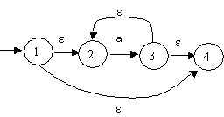

Converting a nfa to a dfa
ε-closure
Defn: The ε-closure of a state is the set of all states,
including S itself, that you can get to via ε-transitions.
The ε-closure of state S is denoted:
Example:
The ε-closure of state 1 = { 1, 2, 4 }
The ε-closure of state 3 = { 3, 2, 4 }
Defn: The ε-closure of a set of states S₁, ... S_{n} is
S₁ ∪ S₂ ∪ ... ∪ S_{n}.
Example: The ε-closure for above states 1 and 3 is
{ 1, 2, 4 } ∪ { 3, 2, 4 } = { 1, 2, 3, 4 }
Notes:
24

Slide 25
To construct a dfa from a nfa
Step 1: Let the start state of the dfa be formed from the
ε-closure of the start state of the nfa.
Subsequent steps: If S is any state that you have previously constructed for the dfa and it is formed from say states t₁, ... , t_{r}
of the nfa, then for any symbol x for which at least one of the
states t₁, ... , t_{r} has a x-successor, the x-successor of S is the
ε-closure of the x-successors of t₁, ... , t_{r}.
Any state of the dfa which is formed from an accepting state, among others, of the nfa becomes an accepting state.
Notes:
25

Slide 26
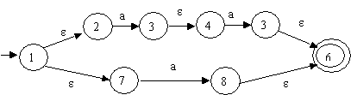
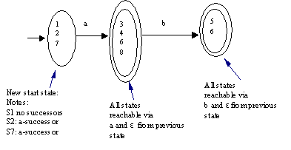
To construct a dfa from a nfa
Example 1: To convert the following nfa:
b
5
we get:
This constructs a dfa that has no epsilon-transitions
Notes:
26

Slide 27
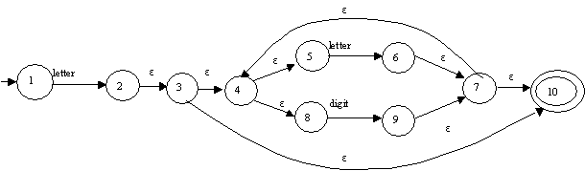
To construct a dfa from a nfa (Cont.2)
Example 2: To convert the nfa for an identifier to a dfa
Notes:
27

Slide 28
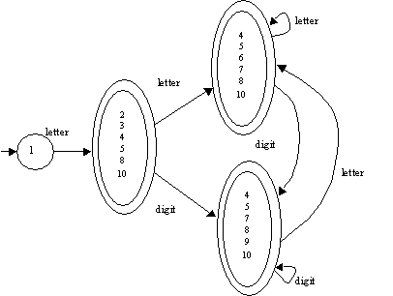
To construct a dfa from a nfa
we get:
Notes:
28

Slide 29
Minimizing the Number of States in a DFA
Step 1: Start with two sets of states
(a) all the accepting states, and
(b) all the non-accepting states
Subsequent steps: Given the sets of states S₁, ... S_{r} consider
each set S and each symbol x in turn. If any member of S has a
x-successor and this x-successor is in say S', then unless all the
members of S have x-successors that are in S', split up S into
those members whose x-successors are in S' and the others
(which don't have x-successors in S').
Notes:
29

Slide 30
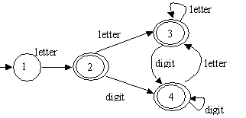
Minimizing the Number of States in a DFA(Cont.1)
Example 1. Consider the dfa we constructed for an identifier (with renumbered states):
Notes:
30

Slide 31

Minimizing the Number of States in a DFA
The sets of states for this dfa are:
S1 S2
Nonaccepting states Accepting states
1 2
3
4
All states in S2 have the successors letter-successor and digit-successor,
and the successor states are all in the set of states S2.
Combine all the states of S2 to get:
Notes:
31

Slide 32
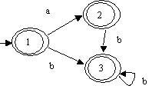
Minimizing the Number of States in a DFA
Example 2. Consider the dfa:
All of the states (1, 2, and 3) are accepting states and all their successors are also accepting states, but state 1 has an a-successor whereas states 2 and 3 do not.
Notes:
32

Slide 33

Minimizing the Number of States in a DFA
So, we split the set of accepting states into two sets S1 and S2 where: S1 consists of state 1, and S2 consists of states 2, 3 to get:
Notes:
33

Slide 34
Complete the following exercises
Find the ε-NFA, DFA and min DFA for the regular
expression
(a|b)* abb
a⁺ | a*b
01* | 1*0

